Slide 1
422 Disassembler Project
Easy68K
Paul, Mitchell, Christopher, Matthew

Slide 2
Overall architecture and design choices
Our design philosophy
Modular and reusable code
Commenting and directions for every line of code
General architecture of our program
I/O, Main Loop, first digit look-up table, display buffers
Program flow

Slide 3
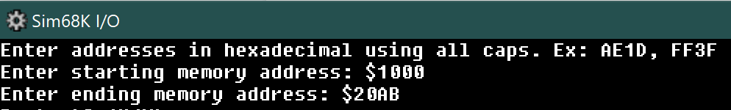
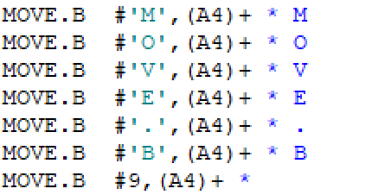
Program welcome screen + inputting memory address range
Example of how we append data to display buffers

Slide 4
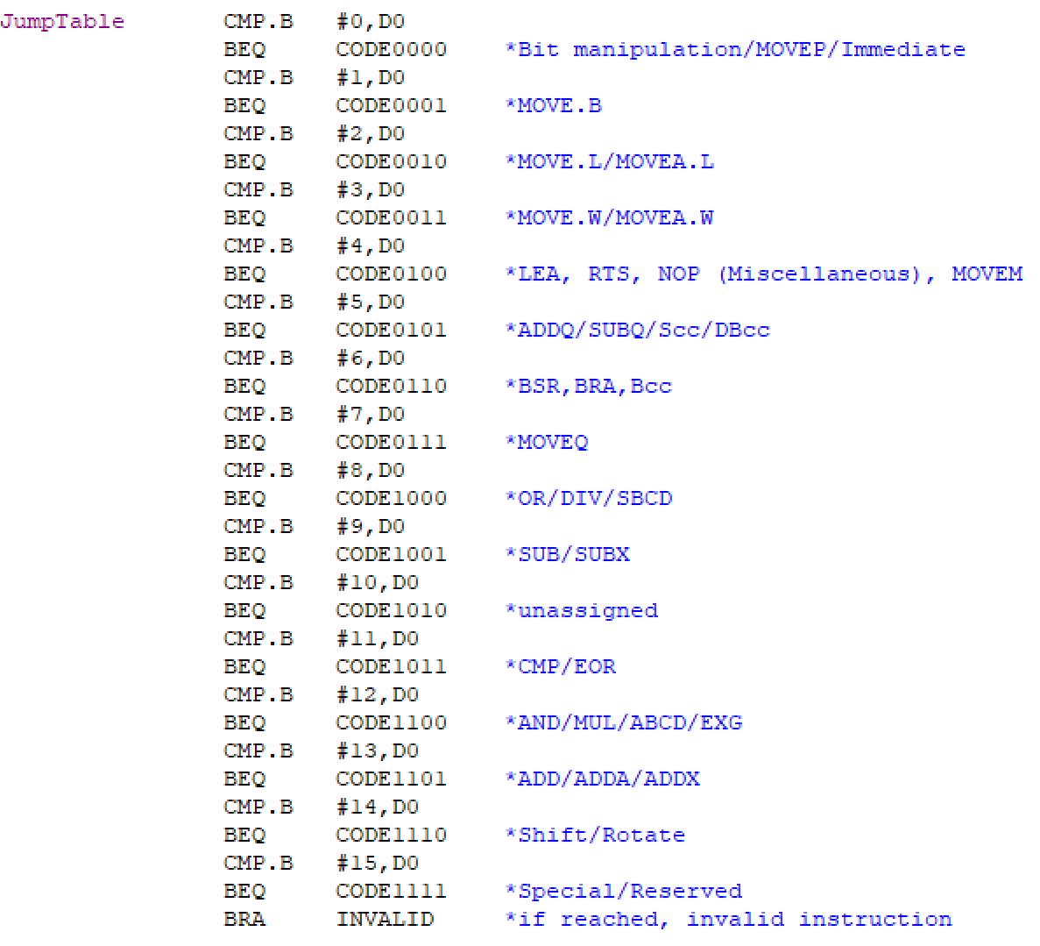
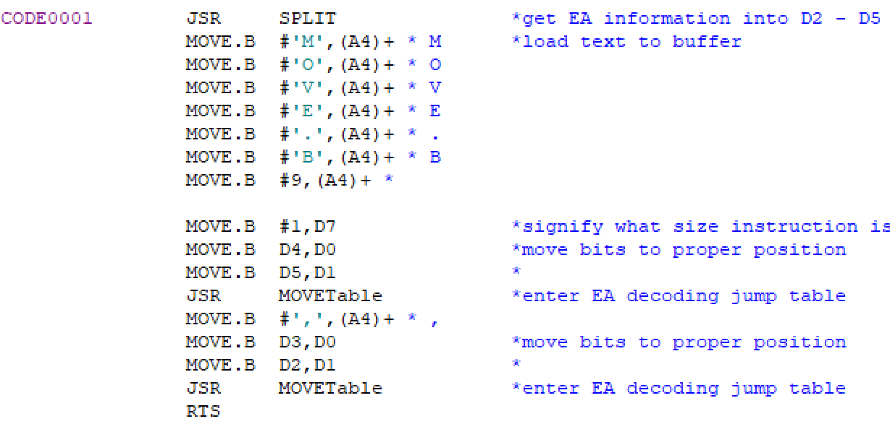
Our main look-up table
When first digit of opcode word is 1

Slide 5
Input validation
Current input validation is a two step process:
Validate input characters
Validate input address range
Low order addresses only and within a specified range defined in variables
Keep MEMStart and MEMEnd variables as the input range for comparison

Slide 6
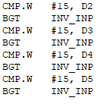
Input validation
In decoding the user ASCII, input is divided into D2 - D5 temporarily
While the decoded input is still in registers
Check if in 0 - F range
Branch away if not

Slide 7
Invalid decoding (invalid instruction)
Decoding an instruction as invalid happens through the various checks to reach a valid instruction
INVALID subroutine gets called whenever something cannot be a valid instruction any longer

Slide 8
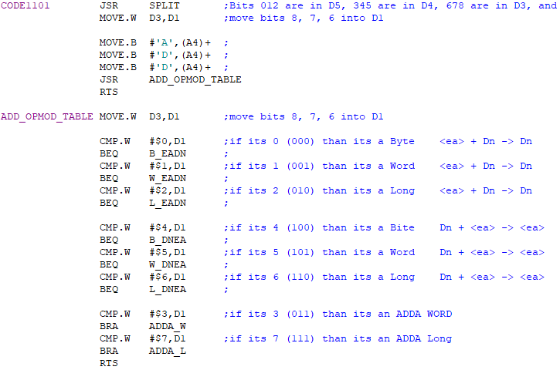
Successful Decoding (CODE1101 ADD/ADDA)
JSR SPLIT
Bits 012 are in D5
Bits 345 are in D4
Bits 678 are in D3
Bits 9,10,11 are in D2
Move the correct Data Register to D1, and
then compare to see what it matches with
In this case its bits 8, 7, 6
We then compare a number to the data register to the Data register to see if it matches
Notes:
** The program reads the input from the user and converts it to Hex. Then the program looks at bits 15-12 and goes through the main jump table comparing 0 to 15 to Data Register 0 to see what matches. The program then jumps to that subroutine and executes it, generally starting with SPLIT.
** I chose CODE1101 (decimal 13) which is the ADD and ADDA instruction.
** Because ADD can have ea+Dn (placed in Dn) and Dn+ea (placed in ea) each letter size (Byte, Word, Long) needs 2 code numbers. (for the example I chose L_DNEA (#$6 or 110))
…… You determine this by looking at bits 8, 7, 6. ...
We compare a number to a data register until we find a match, then we jump to the next section.
Once we found the size (in this case .L). ADD can be <ea> + Dn -> Dn or Dn + <ea> -> <ea>. You determine this by looking at bits 8, 7, 6. In this case we picked DNEA, so the next section up is the Data register.
We compare a number to a data register until we find a match, then we jump to the next section.
Once we found the size (in this case .L). ADD can be <ea> + Dn -> Dn or Dn + <ea> -> <ea>. You determine this by looking at bits 8, 7, 6. In this case we picked DNEA, so the next section up is the Data register.

Slide 9


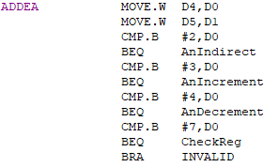
Successful Decoding (continued)
L_DNEA prints .L and a tab
DNEA prints D and moves the register number into D1
EncodeChar turns the ASCII Data Register number into Hex and adds it to the good buffer to be printed
ADDEA adds the effective address and then checks to see if its indirect, or if we need to pre or post decrement it.
CheckReg checks to see if we are using immediate data or an address and prints that out if needed.
If any of these do not work out, then we branch to “INVALID” which exits the subroutine and signals an invalid instruction.
Notes:
** We then print out the “.L” add a tab so that the columns line up and then jump to DNEA
**

Slide 10

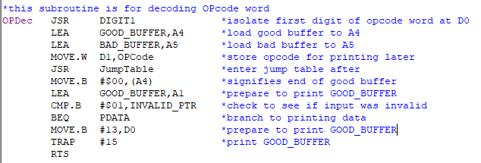
Labelling Invalid Instructions
When unreadable instructions are found a pointer is marked as true
In the OPDec decoding loop this pointer is checked to decide whether the decoded instruction should be printed or data

Slide 11
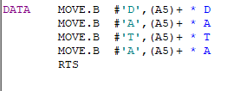
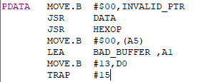

Printing Invalid Instructions as Data
Printing Data
Add “DATA” to buffer
Read data at hex to buffer

Slide 12
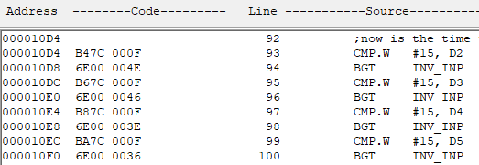
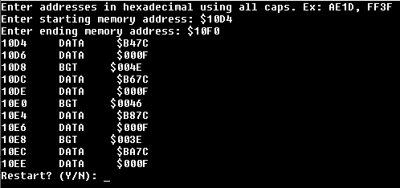
Example: Invalid Instructions
Instructions In Memory:
Console Output:

Slide 13

Example: Invalid Instructions
Instructions In Memory:
Console Output:

